Slide 1
Software Quality Assurance and Testing Technology
2nd Semester, Spring 2021
Haiming Liu
School of Software Engineering
Beijing Jiaotong University

Slide 2
Week 1: The basic concepts and theories of testing
Week 2-3: Principles of Testing
Week 4: Testing the specification
Week 5-6: Black Box Testing
Week 7-9: White Box Testing
Week 10: Integration Testing and System Testing
Week 11: Usability Testing and Accessibility Testing
Week 12: Security Testing
Week 13: Mutation Testing
Week 14: Software Quality
Week 15: Review I
Week 16: Review II

Slide 3
Black-box Testing
Random Testing
Equivalence Partitioning
Boundary Value Analysis
Cause-Effect Analysis

Slide 4
Black-Box testing - Boundary Value Analysis (BVA)
errors hide in the corner
A technique based on identifying, and generating test cases to explore boundary conditions.
Boundary conditions are an extremely rich source of errors.
Natural language based specifications of boundaries are often ambiguous, as in ‘‘for input values of X between 0 and 40,...’’
May be applied to both input and output conditions.
Also applicable to white box testing.
more errors occur at the boundaries of an input domain than in the “center”

Slide 5
Types in Boundary
First/last
Min/Max
Star/Finish
Empty/Full
Slower/Faster
Largest/Smallest
Over/Under
Shortest/Longest
… …
Numeric
Character
Position
Quantity
Speed
Location
Size

Slide 6
Examples of possible boundary conditions
Limits on input data – size, type
Limits on output data- size, type
Look for limits such as
First-1/Last+1
Start-1/Finish+1
Min-1/max+1
Less than empty/ more than full
just Over/Just Under
etc.
Don’t hesitate to choose data outside boundaries, even when it seems absurd.

Slide 7
Boundary Values
Based on experience / heuristics :
Testing boundary conditions of eq. classes is more effective i.e. values directly on, above, and beneath edges of classes
Choose input boundary values as tests in input classes instead of, or additional to arbitrary values
Choose also inputs that invoke output boundary values ( values on the boundary of output classes )
Example strategy as extension of equivalence partitioning:
choose one (n) arbitrary value(s) in each eq. class
choose values exactly on lower /upper boundaries of eq. class
choose values immediately below /above each boundary ( if applicable )

Slide 8
Guidelines for Identifying Boundary Values
1. If the input range is bounded by a and b, then use a, b, and values just above and just below a and b, respectively.
a
b
2. If the input is a number of values, use the minimum and maximum of the values and values just above and just below them, respectively.
a
b
3. Apply guidelines 1 and 2 to create output values at the minimum and maximum expected values.
4. If data structures have boundaries, test these boundary values and values just above and just below them, respectively.
e.g., for an array of bounds 1 to 10
— test array index equal to 0, 1,2, 9, 10, 11

Slide 9
BVA Example
Test a function for calculation of absolute value of an integer
Valid equivalence classes :
Condition Valid eq. classes Invalid eq. Classes
particular abs < 0, >= 0
Test cases :
class x < 0, arbitrary value: x = -10
class x >= 0, arbitrary value x = 100
classes x < 0, x >= 0, on boundary : x = 0
classes x < 0, x >= 0, below and above: x = -1, x = 1

Slide 10
BVA Example
Test a function which limit user input to positive integer (6-digit)
Test cases :
Class arbitrary value: X1 = 123123
Class arbitrary value: X2 = 12345
Class boundary value: X3 = 999999
Class boundary value: X4 = 1
Class boundary value: X5 = 0
Class invalid value: X6 = -1
Class invalid value: X7 = asdasd
Others?
Class invalid value: X8 = 000123
X9 = asd123
X10 = Empty

Slide 11

BVA Example
Test for Phone Number:
Test for ID number（身份证）

Slide 12
BVA Example
If input is a 5-digit integer between 10,000 and 99,999

Slide 13
BVA Example
Individual Income Tax Specification:
If gross pay is no more than ￥36,000, the tax is 3%.
If gross pay is more than ￥36,000, but no more than ￥144,000, the tax is 10%.
If gross pay is more than ￥ 144,000, but no more than ￥300,000, the tax is 20%.
If gross pay is more than ￥ 300,000, but no more than ￥420,000, the tax is 25%.

Slide 14
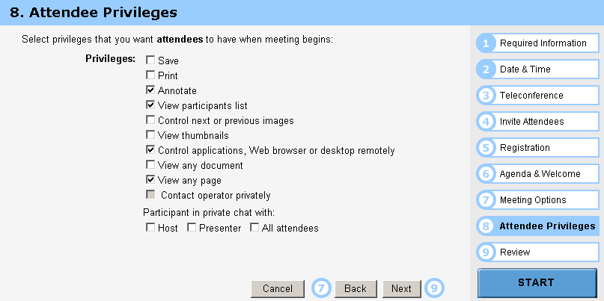
BVA Example

Slide 15
Guidelines for choosing Equivalence classes For Data Testing
Identify sub-boundary conditions or internal boundary conditions
Some limits may not be apparent to the general end user.
To locate some of these, you may need to talk with programmers.
Example: Powers-of-two boundary conditions

Slide 16

Power-of-Two
Binary: 0 and 1, byte is made up of 8 bits, word is made up of 4 bytes, …
Term | Range or Value
Bit Nibble Byte Word Kilo Mega Giga Tera | 0 or 1 0-15 <Half byte> 0-255 0-4294967295 1024 1048576 1073741824 1099511627776
位
半字节
字节
字
千
兆
吉
太

Slide 17
EXAMPLE: Powers-of-Two
Often a programmer will handle data differently depending upon its size.
Example: Communications software where with limited bandwidth, we try to keep the size of data being transmitted low.
Program transmits 256 commands, but uses only a nibble (4 bits) to encode the 15 most commonly used commands.
Thus, there is an internal boundary between the 4th and 5th bit
Might try transmitting 3, 4, 5 bits in addition to ones determined by the stated boundary conditions of 1 and 8 bits.

Slide 18
An Example: A flight simulator
Assume the user can control the height of the plane, determine what those limits are:
Not specified?
Why not?
Nothing in a computer is infinite!
Try flying
Below ground
In outer space
Through a mountain (or some other object)

Slide 19
ASCII Table
Character | ASCII Value | Character | ASCII Value
Null Space / 0 1 2 9 ： @ A | 0 32 47 48 49 50 57 58 64 65 | B Y Z [ ‘ a b y z { | 66 89 90 91 96 97 98 121 122 123

Slide 20
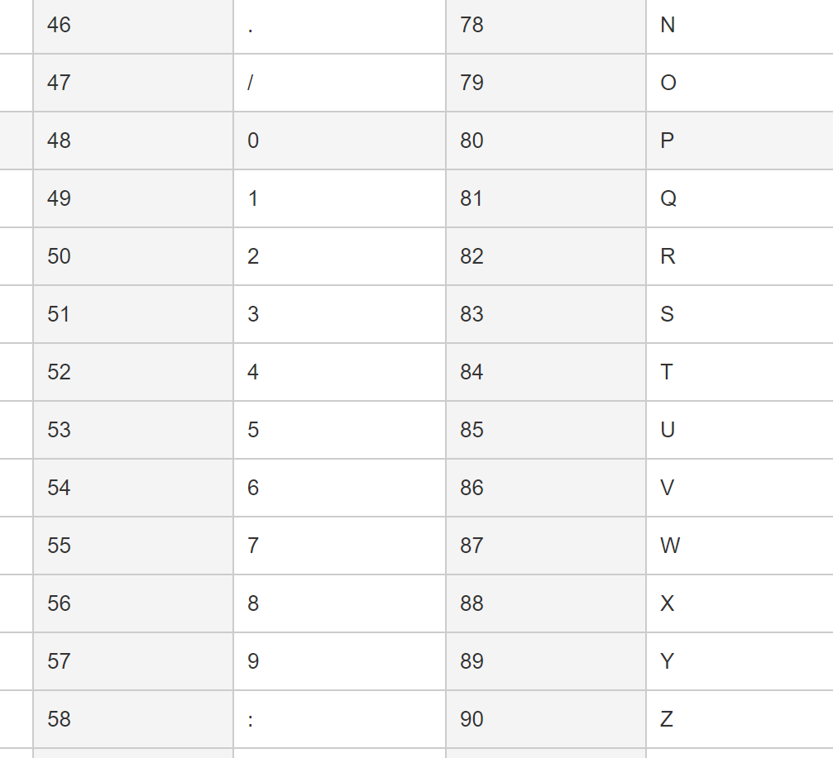
ASCII Encoding Always Produce Sub-Boundary Conditions
The ASCII code is 8 bits.
If numeric digits are to be input,
check just out of range with the ‘/’ and ‘:’

Slide 21
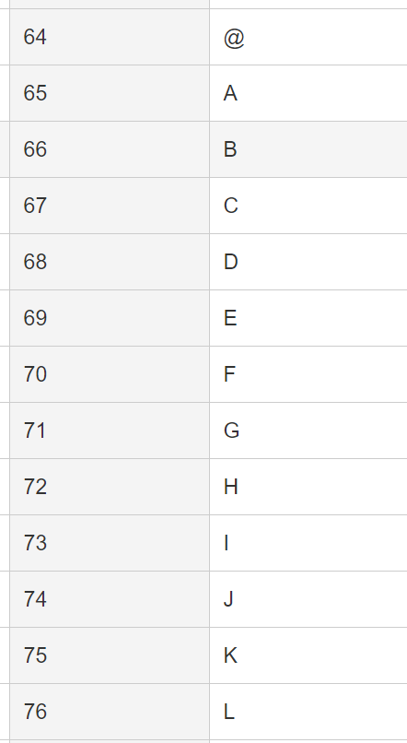
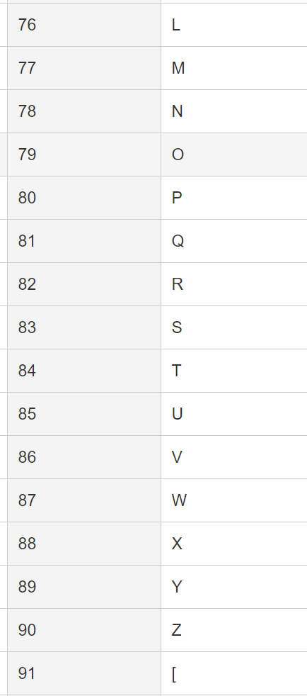
ASCII Encoding Always Produce Sub-Boundary Conditions
The ASCII code is 8 bits.
If capital letters are to be input,
check just out of range with the ‘@’ and ‘[‘

Slide 22
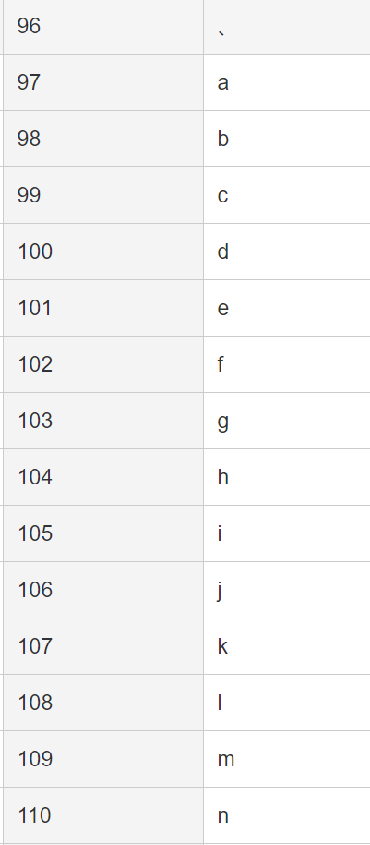
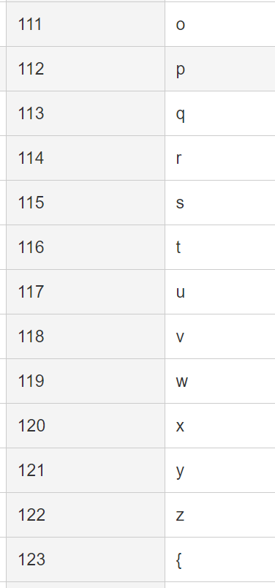
ASCII Encoding Always Produce Sub-Boundary Conditions
The ASCII code is 8 bits.
If lower case letters are to be input,
check just out of range with the forward quote and the ‘{‘.
Notes:
ASCII码是8位。
如果要输入数字，
用“/”和“：”检查超出范围
如果要输入大写字母，
用“@”和“[”检查超出范围
如果要输入小写字母，
用前引号和{检查是否超出范围。

Slide 23
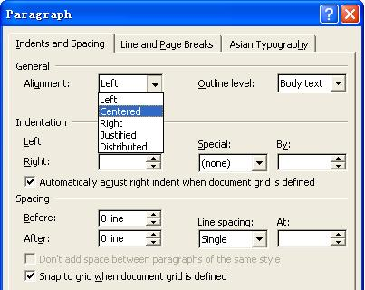
Text-box Field
Default
Empty
Blank
Null
Zero
None

Slide 24
Further Partitioning Possibilities
Check default, empty, blank, null, zero, and no data.
- If nothing is entered, what happens?
- Default set?
- Error message?
- Hung program?
Check invalid, wrong, incorrect, and garbage data.
- Users WILL use the software incorrectly.
- Data loses or crashes are blamed on the software, always --- not the user
- Have fun with this one --- devious, tricky, and nasty are good traits for a tester!

Slide 25
Black-box Testing
Random Testing
Equivalence Partitioning
Boundary Value Analysis
Cause-Effect Analysis

Slide 26
Cause-Effect Analysis
Cause-Effect Analysis is a systematic means for generating test cases to cover different combinations of input ‘‘Causes’’ resulting in output ‘‘Effects.’’
A CAUSE may be thought of as a distinct input condition, or an ‘‘equivalence class’’ of input conditions.
An EFFECT may be thought of as a distinct output condition, or a meaningful change in program state.
Causes and Effects are represented as Boolean variables and the logical relationships among them CAN (but need not) be represented as one or more boolean graphs.

Slide 27
Cause-Effect Analysis
Black-box technique to analyze combinations of input conditions
Identify causes and effects in specification ↓ ↓ inputs outputs current state new state
Make Boolean Graph linking causes and effects
Annotate impossible combinations of causes and effects
Develop decision table from graph with in each column a particular combination of inputs and outputs
Transform each column into test case

Slide 28
Cause-Effect Analysis Sample
Given inputs maxint and N compute result :
|N|
∑
result = if this <= maxint, error otherwise
k
K=0
Valid equivalence classes : condition valid eq. classes abs(N) N < 0, N ≥ 0 maxint ∑ k ≤ maxint, ∑ k > maxint
Test Cases :
maxint N result maxint N result
55 10 55 100 0 0 54 10 error 100 -1 1 56 10 55 100 1 1 0 0 0 … … …

Slide 29
C-E Analysis Process Steps
Cause-effect analysis consists of the following 4 steps
List and label causes (input-events) and effects (output actions) for a module
Draw a cause-effect graph describing the logical combinations of causes, intermediate causes and resulting effects
Develop a decision table (causes vs effects) from the graph
Convert into test cases

Slide 30
C-E Analysis Process Steps
Cause-effect analysis consists of the following 4 steps
List and label causes (input-events) and effects (output actions) for a module
Draw a cause-effect graph describing the logical combinations of causes, intermediate causes and resulting effects
Develop a decision table (causes vs effects) from the graph
Convert into test cases

Slide 31
STEP 1
Given inputs maxint and N compute result :
|N|
∑
result = if this <= maxint, error otherwise
k
K=0
Input-events
Output actions
Causes
Effects
∑ k ≤ maxint
∑ k > maxint
N < 0
N ≥ 0
∑ k
error

Slide 32
C-E Analysis Process Steps
Cause-effect analysis consists of the following 4 steps
List and label causes (input-events) and effects (output actions) for a module
Draw a cause-effect graph describing the logical combinations of causes, intermediate causes and resulting effects
Develop a decision table (causes vs effects) from the graph
Convert into test cases

Slide 33
STEP 2
∑ k ≤ maxint
∑ k > maxint
N < 0
N ≥ 0
∑ k
error
1
0
1
0
1
0
Causes Inputs ∑ k ≤ maxint
∑ k > maxint
N < 0
N ≥ 0
Effects Outputs ∑ k
error

Slide 34
STEP 2
∑ k ≤ maxint
∑ k > maxint
N < 0
N ≥ 0
∑ k
error
1
0
0
1
1
0
Causes Inputs ∑ k ≤ maxint
∑ k > maxint
N < 0
N ≥ 0
Effects Outputs ∑ k
error

Slide 35
STEP 2
∑ k ≤ maxint
∑ k > maxint
N < 0
N ≥ 0
∑ k
error
0
1
1
0
0
1
Causes Inputs ∑ k ≤ maxint
∑ k > maxint
N < 0
N ≥ 0
Effects Outputs ∑ k
error

Slide 36
STEP 2
∑ k ≤ maxint
∑ k > maxint
N < 0
N ≥ 0
∑ k
error
0
1
0
1
0
1
Causes Inputs ∑ k ≤ maxint
∑ k > maxint
N < 0
N ≥ 0
Effects Outputs ∑ k
error

Slide 37
C-E Analysis Process Steps
Cause-effect analysis consists of the following 4 steps
List and label causes (input-events) and effects (output actions) for a module
Draw a cause-effect graph describing the logical combinations of causes, intermediate causes and resulting effects
Develop a decision table (causes vs effects) from the graph
Convert into test cases

Slide 38
STEP 3
∑ k ≤ maxint
∑ k > maxint
N < 0
N ≥ 0
and
∑ k
error
and
xor
Causes Inputs ∑ k ≤ maxint
∑ k > maxint
N < 0
N ≥ 0
Effects Outputs ∑ k
error
1 1 0 0
0 0 1 1
1 0 1 0
0 1 0 1
1 1 0 0
0 0 1 1

Slide 39
Cause-Effect Analysis Sample
Cause
∑ k ≤ maxint
1
1
0
0
∑ k > maxint
0
0
1
1
N < 0
1
0
1
0
N ≥ 0
0
1
0
1
Effects
∑ k
1
1
0
0
error
0
0
1
1
Notes:
决策表

Slide 40
Error Guessing 1
Testers utilize intuition and experience to identify potential errors and design test cases to reveal them.
Guidelines:
Design tests for reasonable but incorrect assumptions that may have been made by developers.
Design tests to detect errors in handling special situations or cases.
Design tests to explore unexpected or unusual program use or environmental scenarios.

Slide 41
Error Guessing 2
Examples of conditions to explore:
(1) Repeated instances or occurrences
(2) Blanks or null characters in strings (etc.)
(3) Negative numbers
(4) Non-numeric values in numeric fields
(5) Inputs that are too long or two short Using intuition and experience, identify tests you would

Slide 42
Error Guessing 3
Just ‘guess’ where the errors are ……
Intuition and experience of tester
Strategy:
Make a list of possible errors or error-prone situations ( often related to boundary conditions )
Write test cases based on this list

Slide 43
Error Guessing 4
More sophisticated ‘error guessing’: Risk Analysis
Try to identify critical parts of program ( high risk code sections ):
parts with unclear specifications
developed by junior programmer while his wife was pregnant ……
complex code : measure code complexity - tools available (Logiscope,…)
High-risk code will be more thoroughly tested ( or be rewritten immediately ……)

Slide 44
Which One to Choose?
Black-box testing techniques :
Equivalence partitioning
Boundary value analysis
Cause-effect analysis
Error guessing
…………
Test derivation from formal specification, Which one to use ?
None of them is complete
All are based on some kind of heuristics
They are complementary

Slide 45
Which One to Choose?
Always use a combination of techniques
When a formal specification is available try to use it
Identify valid and invalid input equivalence classes
Identify output equivalence classes
Apply boundary value analysis on valid equivalence classes
Guess about possible errors
Cause-effect graphing for linking inputs and outputs

Slide 46
STATE TESTING
All software flows from one state to another.
For some software, these state changes are obvious:
Paint Program
To determine states, we need to build a state transition diagram or state transition map.
Good requirements or specifications often include these.
There are software tools for drawing them.
Different diagramming techniques exist --- we’ll use just one, but it is not the only one possible.

Slide 47
Definition: State Transition Map
A STM is a graph showing the logic flow from state to state in the program. This is diagrammed using the symbols:
a state
the start state
a transition
All of these are labeled
States- to identify them
Transitions- to identify what triggers movement from one state to another state.

Slide 48
Example of Part of STM
Display dialog box
Correct username & password entered
idle
Press Ctrl/Alt/ Delete
Incorrect username or password entered
Click OK
Display error message
Obviously, these can become quite large!!

Slide 49
What the STM Shows
Each unique state of the software.
Input or condition needed to move from one state to the next.
What is set or what output is produced when a state is entered or exited.
Obviously, we can’t investigate all possible paths through the state transition map (this is really the “traveling salesperson problem”).

Slide 50
Use Equivalence Partitioning to Choose Test Cases for State Testing
Possible choices for partitioning:
Try to visit each state at least once.
Test the most common or popular state-to-state transitions.
Test the least common paths between states.
Test all entrances and exits from error states.
Test random state transitions --- i.e. throw darts a the transition state map!
All of these are testing-to-pass cases.

Slide 51
More on State Testing
Involves checking all state variables which define a state.
It is suggest that checking with the spec writers and programmers to identify possible states --- but, caution
DO NOT GO TO THE CODE LEVEL!
Programmers will tend to want to drag out code if it exists!

Slide 52
Testing-to-Fail State Testing
Check race conditions – a timing problem causes the execution to not proceed as planned.
Try interrupting the program in the middle of its execution as see what happens.
Is data lost?
Can the program be restarted in a clean condition?
Start two instances of the same program and input to both.
What happens?

Slide 53
Repetition, Stress & Load Testing
Repetition testing can often find memory leaks --- memory not freed completely when it should be.
Stress testing tries to run under bad conditions --- low memory, slow CPU, etc.
Load testing overloads the program with huge data files, long periods of execution, etc.
Round all of this out by just playing like a dumb user! (But, call them an inexperienced user, please!)

Slide 54
To be continued… See you next week

